Slide 1
Section 5
Behavior-Driven Development
User Stories
Behavior-Driven Development
Cucumber
Selenium
Notes:
20170313
Copyright © 2017 nTier Training, LLC. All rights reserved.
5-<number>
TDD and BDD

Slide 2
Section Objectives
Be able to discuss the important points of Behavior-Driven Development (BDD)
Learn how to use Cucumber-JVM and how it leverages BDD
Create Scenarios and Scenario Outlines
Test websites using Selenium and Cucumber-JVM
20170313
Copyright © 2017 nTier Training, LLC. All rights reserved.
5-<number>
Notes:
20170313
Copyright © 2017 nTier Training, LLC. All rights reserved.
5-<number>
TDD and BDD

Slide 3
Behavior-Driven Development
User Stories
User Stories
Behavior-Driven Development
Cucumber
Selenium
Notes:
20170313
Copyright © 2017 nTier Training, LLC. All rights reserved.
5-<number>
TDD and BDD

Slide 4
A Refresher on Stories
A User Story is a short, simple description of a feature told from the perspective of the person who desires the new capability, usually a user or customer of the system. User stories typically follow a simple template:
  As a <type of user>, I want <some goal> so that <some reason>
User stories are often written on index cards or sticky notes, stored in a shoe box and arranged on walls or tables to facilitate planning and discussion. As such, they strongly shift the focus from writing about features to discussing them. In fact, these discussions are more important than whatever text is written
20170313
Copyright © 2017 nTier Training, LLC. All rights reserved.
5-<number>
Notes:
User stories generally follow a template similar to the following:
As a <role>, I want <goal/desire> so that <benefit>
An example could be: As a user, I want to search for my customers by their first and last names
20170313
Copyright © 2017 nTier Training, LLC. All rights reserved.
5-<number>
TDD and BDD

Slide 5
Product Backlog Story Validation
Is this enough?
  As a <user type>, I want to <business function> so that <business value>dates
  As a registered user, I want to view my account information so I can update my credit card numbers and expiration
  Must also include a validation and a size
Acceptance criteria define the parameters of a user story and determine when a story is completed and working as expected
They add certainty to what the team is building
20170313
Copyright © 2017 nTier Training, LLC. All rights reserved.
5-<number>
Notes:
20170313
Copyright © 2017 nTier Training, LLC. All rights reserved.
5-<number>
TDD and BDD

Slide 6
Acceptance Criteria
My Story:
  “As a user of the library catalogue, I want advanced search options on the front page so that I can quickly and easily refine my search”
The acceptance criteria are written in simple language that the customer would use, just like the user story. For the example above, the acceptance criteria could include:
  I can limit the search by format/type
  I can delineate the search by date range
  I can limit the search to publisher information such as title, author, subject, place, publisher and call number
  I can restrict the search to a particular website/catalogue or collection
  I can find advanced search options – advanced search options are carried through as filters to search results page
  I can filter by availability
20170313
Copyright © 2017 nTier Training, LLC. All rights reserved.
5-<number>
Notes:
20170313
Copyright © 2017 nTier Training, LLC. All rights reserved.
5-<number>
TDD and BDD

Slide 7
INVEST in Good Stories
INVEST in Good User Stories
Independent – User Stories should be as independent as possible
Negotiable – User Stories are not a contract. They are not detailed specifications. They are reminders of features for the team to discuss and collaborate on to clarify the details near the time of development
Valuable – User Stories should be valuable to the business of the solution. They should be written in user language. They should be features, not tasks
Estimable – User Stories need to be possible to estimate. They need to provide enough information to estimate, without being too detailed
Small – User Stories should be small. Not too small, but not too big
Testable – User Stories need to be testable
INVEST created by Bill Wake - http://xp123.com/articles/invest-in-good-stories-and-smart-tasks/
20170313
Copyright © 2017 nTier Training, LLC. All rights reserved.
5-<number>
Notes:
20170313
Copyright © 2017 nTier Training, LLC. All rights reserved.
5-<number>
TDD and BDD

Slide 8
Behavior-Driven Development
Behavior-Driven Development
User Stories
Behavior-Driven Development
Cucumber
Selenium
Notes:
20170313
Copyright © 2017 nTier Training, LLC. All rights reserved.
5-<number>
TDD and BDD

Slide 9
Behavior-Driven Development
Behavior-Driven Development (or BDD) is an Agile software technique that encourages collaboration between developers and non-technical or business participants in a software project
It was originally named in 2003 by Dan North as a response to Test-Driven Development (TDD)
BDD focuses on obtaining a clear understanding of desired software behavior through discussion with stakeholders to include acceptance test- or customer test-driven development
It extends TDD by writing test cases in a natural language that non-programmers can read
20170313
Copyright © 2017 nTier Training, LLC. All rights reserved.
5-<number>
Notes:
20170313
Copyright © 2017 nTier Training, LLC. All rights reserved.
5-<number>
TDD and BDD

Slide 10
BDD
The aim of BDD is to use terminology that is focused on the behavioral aspects of the system rather than testing
BDD aims to bridge the gap between the differing views of computer systems held by business users and technologists
Its focus is on minimizing the hurdles between specification, design, implementation and confirmation of the behavior of a system
BDD relies on the use of a very specific (and small) vocabulary to minimize miscommunication and to ensure that everyone (i.e., the business, developers, testers, analysts and managers) is not only on the same page but also using the same words
20170313
Copyright © 2017 nTier Training, LLC. All rights reserved.
5-<number>
Notes:
It must be stressed that BDD is a rephrasing of existing good practice; it is not a radically new departure. Its aim is to bring together existing, well-established techniques under a common banner with consistent and unambiguous terminology
20170313
Copyright © 2017 nTier Training, LLC. All rights reserved.
5-<number>
TDD and BDD

Slide 11
The BDD Process
A Business User works with a Business Analyst to identify a business requirement. This is expressed as a User Story using a template like the one below:
  As a Role
  I request a Feature
  To gain a Benefit
The speaker, who holds the Role, is the person who will gain the Benefit from the requested Feature
This can be paraphrased in a variety of ways, such as:
  I want to achieve a specific Goal, and as a Role I should be able to accomplish this by performing Functionality
  A Role invokes Feature to cause a Benefit
20170313
Copyright © 2017 nTier Training, LLC. All rights reserved.
5-<number>
Notes:
20170313
Copyright © 2017 nTier Training, LLC. All rights reserved.
5-<number>
TDD and BDD

Slide 12
A New Template
However, a story’s behavior can be defined by acceptance criteria (i.e., what deems it to succeed or fail). As such it can be described in terms of scenarios, which can take the following form:
  Given some initial context,
  When an event occurs,
  then ensure an outcome
The fragments of the scenario are fine-grained enough to be represented directly in code
20170313
Copyright © 2017 nTier Training, LLC. All rights reserved.
5-<number>
Notes:
To illustrate, let’s use the classic example of an ATM machine
One of the story cards might look like this:
As a customer,
I want to withdraw cash from an ATM,
so that I don’t have to wait in line at the bank
20170313
Copyright © 2017 nTier Training, LLC. All rights reserved.
5-<number>
TDD and BDD

Slide 13
Behavior Driven Development
Cucumber
User Stories
Behavior Driven Development
Cucumber
Selenium
Notes:
20170313
Copyright © 2017 nTier Training, LLC. All rights reserved.
5-<number>
TDD and BDD

Slide 14
Cucumber
Cucumber executes plain text as automated tests
Tests written in business facing text
The test is written in Gherkin
Interacts with the target language
Cucumber-JVM is a pure Java implementation of Cucumber with native support for the most popular JVM languages: Java, Scala, Groovy, Clojure, Rhino, Jython and JRuby
20170313
Copyright © 2017 nTier Training, LLC. All rights reserved.
5-<number>
Notes:
20170313
Copyright © 2017 nTier Training, LLC. All rights reserved.
5-<number>
TDD and BDD

Slide 15
Gherkin
The challenge with writing good automated acceptance tests is that, for them to be really effective, they need to be readable by not only the computer but also by our stakeholders
It’s this human readability that allows us to get feedback about what we’re building while we’re building it. This is where Gherkin comes in
Gherkin gives us a lightweight structure for documenting examples of the behavior our stakeholders want in a way that can be easily understood both by the stakeholders and by Cucumber
Although we can call Gherkin a programming language, its primary design goal is human readability, meaning you can write automated tests that read like documentation
20170313
Copyright © 2017 nTier Training, LLC. All rights reserved.
5-<number>
Notes:
20170313
Copyright © 2017 nTier Training, LLC. All rights reserved.
5-<number>
TDD and BDD

Slide 16
Feature
Gherkin files use the .feature file extension. They’re saved as plain text, meaning they can be read and edited with simple tools. A Gherkin file is given its structure and meaning using a set of special keywords (see notes)
Each Gherkin file begins with the Feature keyword. This keyword doesn’t really affect the behavior of your Cucumber tests at all; it just gives you a convenient place to put some summary documentation about the group of tests that follow
Feature: Quote
This is the description of the feature, which can
span multiple lines.
You can even include empty lines, like this one:
In fact, everything until the next Gherkin keyword is included
in the description.
20170313
Copyright © 2017 nTier Training, LLC. All rights reserved.
5-<number>
Notes:
Keywords:
Feature
Background
Scenario
Given
When
Then
And
But
Background
Scenario Outline
The text immediately following on the same line as the Feature keyword is the name of the feature, and the remaining lines are its description
You can include any text you like in the description except a line beginning with one of the words Scenario, Background or Scenario Outline
20170313
Copyright © 2017 nTier Training, LLC. All rights reserved.
5-<number>
TDD and BDD

Slide 17
Scenario
Feature
In valid Gherkin, a Feature must be followed by the keyword Scenario
A Scenario actually expresses the behavior we want
Each feature contains several scenarios, and each scenario is a single concrete example of how the system should behave in a particular situation
Scenarios all follow the same pattern:
    Get the system into a particular state
    Manipulate it
    Examine the new state
So, we start with a context, go on to describe an action and then finally check that the outcome was what we expected
20170313
Copyright © 2017 nTier Training, LLC. All rights reserved.
5-<number>
Notes:
Background and Scenario Outline can also be used instead of Scenario
If you add together the behavior defined by all of the scenarios, that’s the expected behavior of the feature itself
20170313
Copyright © 2017 nTier Training, LLC. All rights reserved.
5-<number>
TDD and BDD

Slide 18
Scenario – Given, When, Then
Feature
In Gherkin, we use the keywords Given, When and Then to identify the three different parts of the scenario
Each of the lines in a scenario is known as a step
Feature: Quote
Some description
Scenario: getting a quote
Given I am a 42-year-old man in "good" health
When I ask for a 10 year term
Then my monthly premium will be 37
20170313
Copyright © 2017 nTier Training, LLC. All rights reserved.
5-<number>
Notes:
So, we use:
Given to set up the context where the scenario happens
When to interact with the system somehow
Then to check that the outcome of that interaction was what we expected
We can add more steps to each Given, When or Then section of the scenario using the keywords “And” and “But”
20170313
Copyright © 2017 nTier Training, LLC. All rights reserved.
5-<number>
TDD and BDD

Slide 19
JUnit
We can utilize JUnit to run this .feature with a specific Runner for cucumber tests. Classes annotated with @RunWith(Cucumber.class) will run a Cucumber Feature
cucumber.api.junit.Cucumber will look for a .feature file on the classpath, using the same resource path as the annotated class. The class should be empty without any fields or methods
Running this Junit will give the output below (see notes)
@RunWith(Cucumber.class)
public class RunTests {
}
20170313
Copyright © 2017 nTier Training, LLC. All rights reserved.
5-<number>
Notes:
You can implement missing steps with the snippets below:
@Given("^I am a (\\d+) years old man in \"([^\"]*)\" health$")
public void I_am_a_years_old_man_in_health(int arg1, String arg2) {
// Express the Regexp above with the code you wish you had
throw new PendingException();
}
@When("^I ask for a (\\d+) year term$")
public void I_ask_for_a_year_term(int arg1) {
// Express the Regexp above with the code you wish you had
throw new PendingException();
}
@Then("^my monthly premium will be (\\d+)$")
public void my_monthly_premium_will_be(int arg1) {
// Express the Regexp above with the code you wish you had
throw new PendingException();
}
20170313
Copyright © 2017 nTier Training, LLC. All rights reserved.
5-<number>
TDD and BDD

Slide 20
Step Definitions
Step Definitions
We will create a Java class in the same package structure as our feature, using the step definitions cucumber recommended as the starting point
public class InsureDefinitions {
  @Given("^I am a (\\d+) years old man in \"([^\"]*)\" health$")
  public void m1(int age, String health) {
  throw new PendingException();
  }
  @When("^I ask for a (\\d+) year term$")
  public void m2(int years) {
  throw new PendingException();
  }
  @Then("^my monthly premium will be (\\d+)$")
  public void m3(int balance) {
  throw new PendingException();
  }
}
20170313
Copyright © 2017 nTier Training, LLC. All rights reserved.
5-<number>
Notes:
The implementation for the methods of throw new PendingException(); is like a TODO as the test will FAIL until you implement the methods with Java code
20170313
Copyright © 2017 nTier Training, LLC. All rights reserved.
5-<number>
TDD and BDD

Slide 21
Cucumber Expressions
Regular expressions are a big part of what makes Cucumber tests expressive in English
The regular expression:
Matches: OR
So, to avoid ambiguity, use Anchors:
Matching specific words is fine, but you often want flexibility to match a variety of strings (see notes)
I’m logged in
I’m logged in
I'm logged in as an admin
^I'm logged in$.
20170313
Copyright © 2017 nTier Training, LLC. All rights reserved.
5-<number>
Notes:
Capture a variety of Strings:
.* matches anything (or nothing), literally “any character (except a newline) 0 or more times”
.+ matches at least one of anything
[0-9]* or d* matches a series of digits (or nothing)
[0-9]+ or d+ matches one or more digits"[^"]
*“ matches something (or nothing) in double quotes
? matches a or an (the question mark makes the n optional)
20170313
Copyright © 2017 nTier Training, LLC. All rights reserved.
5-<number>
TDD and BDD

Slide 22
Cucumber Expressions – Capture Groups
When you put part of a regular expression in parentheses, whatever it matches gets captured for use later. This is known as a “capture group”
Typically, if you’re using a wildcard, you probably want to capture the matching value for use in your step definition
If the step below is, “Given I'm logged in as an admin,” then the step definition gets passed "admin" for role
While if the step below is, “Given I am a 50 year old man in ‘good’ heath,” then the step definition gets passed 50 and “good”
  Given(@"^I'm logged in as an? (.*)$")
  public void ImLoggedInAsA(string role) {
  throw new PendingException();
  }
@Given("^I am a (\\d+) years old man in \"([^\"]*)\" health$")
public void m1(int age, String health) {
throw new PendingException();
}
20170313
Copyright © 2017 nTier Training, LLC. All rights reserved.
5-<number>
Notes:
The parentheses and pipe indicate a logical OR - just what I need to match two different strings
@When(@"^(I'm logged|I log) in as an? (.*)$")
public void LogInAs(string role) {
throw new PendingException();
}
20170313
Copyright © 2017 nTier Training, LLC. All rights reserved.
5-<number>
TDD and BDD

Slide 23
Step Definitions
Step Definitions
We can now implement our first step definition
First, we need to correlate our “feature” steps with their Java step counterparts in the StepDefinitions class
The expressions do the job for us
The expression is used to inject the arguments into our Java method by position. As we start to “implement” the step with Java code, the compiler “forces our hand”
Given I am a 42 years old man in "good" health
@Given("^I am a (\\d+) years old man in \"([^\"]*)\" health$")
@Given("^I am a (\\d+) years old man in \"([^\"]*)\" health$")
public void m1(String health, int age) {
  Insured insured = new Insured(age, health);
  Quote quote = new Quote();
  quote.setInsured(insured);
}
20170313
Copyright © 2017 nTier Training, LLC. All rights reserved.
5-<number>
Notes:
We add the code required by the test (the compiler forces us to)
public class Insured {
private String health;
private int age;
public Insured(String health, int age) {
super();
this.health = health;
this.age = age;
}
}
public class Quote {
private Insured insured;
public Insured getInsured() {
return insured;
}
public void setInsured(Insured insured) {
this.insured = insured;
}
}
20170313
Copyright © 2017 nTier Training, LLC. All rights reserved.
5-<number>
TDD and BDD

Slide 24
Complete the Scenario
Step Definitions
We can then complete the other steps and confirm results via an Assert
Scenario: getting a quote
Given I am a 42 years old man in "good" health
When I ask for a 10 year term
Then my monthly premium will be 37
public class InsureDefinitions {
  private Quote quote;
  @Given("^I am a (\\d+) years old man in \"([^\"]*)\" health$")
  public void m1(int age, String health) {
    Insured insured = new Insured(health, age);
    quote = new Quote();
    quote.setInsured(insured);
  }
  @When("^I ask for a (\\d+) year term$")
  public void m2(int years) {
    quote.setYears(years);
  }
  @Then("^my monthly premium will be (\\d+)$")
  public void m3(int balance) {
    int actual = quote.calc();
    Assert.assertEquals(balance, actual);
  }
}
20170313
Copyright © 2017 nTier Training, LLC. All rights reserved.
5-<number>
Notes:
Quote has now been defined at the class level to enable it to be used in all the methods of the class
Quote (and Insured) is evolving
public int calc() {
return (int) (getHealthFactor() * insured.getAge()) ;
}
private double getHealthFactor(){
double result = 1.0;
if (insured.getHealth().equalsIgnoreCase("good")){
result = result * 0.90;
}
return result;
}
20170313
Copyright © 2017 nTier Training, LLC. All rights reserved.
5-<number>
TDD and BDD

Slide 25
Complete the Scenario
Step Definitions
We can add more steps to each Given, When or Then section of the scenario using the keywords “And” and “But”:
Scenario: getting a quote
Given I am a 42 years old man in "good" health
But I only exercise 2 times a week
When I ask for a 10 year term
Then my monthly premium will be 37
And my status should be "approved"
@But("^I only exercise (\\d+) times a week$")
public void I_only_exercise_times_a_week(int arg1) {
insured.setExerciseFrequency(arg1);
}
@And("^my status should be \"([^\"]*)\"$")
public void I_my_status_should_be(String arg1) {
Assert.assertEquals(arg1,quote.getStatus());
}
Our Domain Classes
are evolving
20170313
Copyright © 2017 nTier Training, LLC. All rights reserved.
5-<number>
Notes:
public class Quote {
public int calc() {
return (int) (getHealthFactor() * insured.getAge()) ;
}
private double getHealthFactor(){
double result = 1.0;
if (insured.getHealth().equalsIgnoreCase("good")){
result = result * 0.90;
}
if (insured.getExerciseFrequency() > 3){
result = result * 0.90;
}
return result;
}
public String getStatus() {
String status = "rejected";
if(calc() < 40){
status = "approved";
}
return status;
}
20170313
Copyright © 2017 nTier Training, LLC. All rights reserved.
5-<number>
TDD and BDD

Slide 26
Complete the Scenario - Alternative
Step Definitions
Cucumber doesn’t actually care which of these keywords you use; the choice is simply there to help you create the most readable scenario
If you don’t want to use And or But, you could write the previous scenario like this, and it would still work exactly the same way
Scenario: getting a quote
Given I am a 42 years old man in "good" health
Given I only exercise 2 times a week
When I ask for a 10 year term
Then my monthly premium will be 37
Then my status should be "approved"
@Given("^I only exercise (\\d+) times a week$")
public void I_only_exercise_times_a_week(int arg1) {
@Then("^my status should be \"([^\"]*)\"$")
public void I_my_status_should_be(String arg1) {
20170313
Copyright © 2017 nTier Training, LLC. All rights reserved.
5-<number>
Notes:
20170313
Copyright © 2017 nTier Training, LLC. All rights reserved.
5-<number>
TDD and BDD

Slide 27
Too Verbose?
Step Definitions
Some people find Given, When, Then, And and But a little verbose. There is an additional keyword you can use to start a step: * (an asterisk)
It actually generates @Given expressions when run without a StepDefinition Class, but you can still use the other key worlds in the StepDefinition expressions
Scenario: getting a quote
* I am a 42 years old man in "good" health
* I only exercise 2 times a week
* I ask for a 10 year term
* my monthly premium will be 37
* my status should be "approved"
@Given("^I only exercise (\\d+) times a week$")
public void I_only_exercise_times_a_week(int arg1) {
@Given("^my status should be \"([^\"]*)\"$")
public void I_my_status_should_be(String arg1) {
20170313
Copyright © 2017 nTier Training, LLC. All rights reserved.
5-<number>
Notes:
The only thing that matters is that everybody understands what is communicated
20170313
Copyright © 2017 nTier Training, LLC. All rights reserved.
5-<number>
TDD and BDD

Slide 28
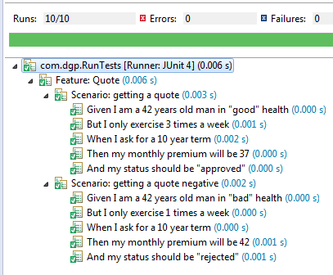
Add More Scenarios
Step Definitions
We can start adding further Scenarios. Below we use the same StepDefinition Class
Feature: Quote
Getting a Life Quote
Scenario: getting a quote
Given I am a 42 years old man in "good" health
But I only exercise 3 times a week
When I ask for a 10 year term
Then my monthly premium will be 37
And my status should be "approved"
Scenario: getting a quote negative
Given I am a 42 years old man in "bad" health
But I only exercise 1 times a week
When I ask for a 10 year term
Then my monthly premium will be 42
And my status should be "rejected"
20170313
Copyright © 2017 nTier Training, LLC. All rights reserved.
5-<number>
Notes:
20170313
Copyright © 2017 nTier Training, LLC. All rights reserved.
5-<number>
TDD and BDD

Slide 29
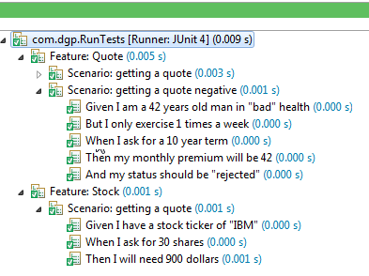
Add Different Scenarios
Step Definitions
We can start adding very different Scenarios in the same .feature file or in its own
Feature: Quote
Getting a Life Quote
Scenario: getting a quote
Given I am a 42 years old man in "good" health
But I only exercise 3 times a week
When I ask for a 10 year term
Then my monthly premium will be 37
And my status should be "approved"
Scenario: getting a quote negative
Given I am a 42 years old man in "bad" health
But I only exercise 1 times a week
When I ask for a 10 year term
Then my monthly premium will be 42
And my status should be "rejected"
Feature: Stock
Get a Stock Price
Scenario: getting a quote
Given I have a stock ticker of "IBM"
When I ask for 30 shares
Then I will need 900 dollars
20170313
Copyright © 2017 nTier Training, LLC. All rights reserved.
5-<number>
Notes:
The classpath reconciles the appropriate StepDefinition class as based off the .feature vs StepDefinition Expressions
20170313
Copyright © 2017 nTier Training, LLC. All rights reserved.
5-<number>
TDD and BDD

Slide 30
Using Doubles
In our .feature files, we have expressions for digits and Strings. So what if we want to inject doubles into our StepDefinition methods? Options include:
private CoffeeBar bar;
@Given("^A store sells coffee at (\\d+).(\\d+) a cup$")
public void A_store_sells_coffee_at_a_cup(double arg1, double arg2) {
  bar = new CoffeeBar()
  double price = arg1 + (arg2 / 100);
  bar.setPrice(price);
}
@When("^I ask for (\\d+) cups$")
public void I_ask_for_a_cup(int arg1) {
  bar.setQty(arg1);
}
@Then("^my bill will be \"([^\"]*)\"$")
public void my_bill_will_be(String arg1) {
double expected = Double.parseDouble(arg1);
Assert.assertEquals(expected, bar.makeOrder(), 0.001);
}
Receive the digits as doubles; one double represents the digits before the decimal place and the other the fractional side of the “number”
Parse a received String into a double
20170313
Copyright © 2017 nTier Training, LLC. All rights reserved.
5-<number>
Notes:
Feature: Coffee
Scenario: getting a cup of coffee
Given A store sells coffee at 3.99 a cup
When I ask for 1 cups
Then my bill will be "3.99"
Scenario: getting two cups of coffee
Given A store sells coffee at 3.99 a cup
When I ask for 2 cups
Then my bill will be "7.98"
20170313
Copyright © 2017 nTier Training, LLC. All rights reserved.
5-<number>
TDD and BDD

Slide 31
Lab 5.1
Cucumber - Scenario
Notes:
20170313
Copyright © 2017 nTier Training, LLC. All rights reserved.
5-<number>
TDD and BDD

Slide 32
Lab 5.1 - Cucumber
Lab 5.4 - Walk
Import into eclipse a starter project Lab05.1
We will run Cucumber to test out our LifeQuoter application. We still do NOT have an implementation for the Interface MedicalServiceRating, so once again we must inject in a Mock Object
In the file src\main\resources\com\ntier\life\insurance\insure.feature, write a Scenario where: If you are 30 year old male, when you have a medicalId of 10001, your premium should be 30.18
A JUnit has been provided. Run it to see what your StepDefinition expressions should look like. Copy and paste these steps into the class cpm.ntier.life.insurance. LifeQuoterStepDefinition
20170313
Copyright © 2017 nTier Training, LLC. All rights reserved.
5-<number>
Notes:
20170313
Copyright © 2017 nTier Training, LLC. All rights reserved.
5-<number>
TDD and BDD

Slide 33

Lab 5.1 – Step Definitions
Lab 5.4 - Walk
In the class LifeQuoterStepDefinition
  Implement each step. You have to inject into an instance of LifeQuoter an Insured Object (via its constructor) and a MedicalRatingService Mock using Mockito. Set expectations on the Mock using MedicalId as below:
The premium is a double, so think about how you are going to get that into this StepDefinitions class
MedicalServiceRating service = Mockito.mock(MedicalRatingService.class);
Mockito.when(service.requestMedicalRating(10001)).thenReturn("EXCELLENT");
Mockito. when(service.requestMedicalRating(8001)).thenReturn("GOOD");
Mockito.when(service.requestMedicalRating(7005)).thenReturn("GOOD");
Mockito.when(service.requestMedicalRating(1001)).thenReturn("POOR");
20170313
Copyright © 2017 nTier Training, LLC. All rights reserved.
5-<number>
Notes:
Write further Scenarios to test your Mock
20170313
Copyright © 2017 nTier Training, LLC. All rights reserved.
5-<number>
TDD and BDD

Slide 34
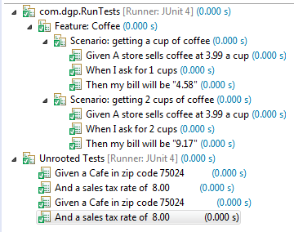
A Background
Step Definitions
A Background is much like a scenario containing a number of steps. The difference is that the background is run before each of your scenarios
Feature: Coffee
Background:
Given a Cafe in zip code 75024
And a sales tax rate of 5.00
Scenario: getting a cup of coffee
Given A store sells coffee at 3.99 a cup
When I ask for 1 cups
Then my bill will be "4.58"
Scenario: getting 2 cups of coffee
Given A store sells coffee at 3.99 a cup
When I ask for 2 cups
Then my bill will be "9.17"
@Given("^a Cafe in zip code (\\d+)$")
public void a_Cafe_in_zip_code(int arg1) {
city = new City(arg1);
}
@Given("^a sales tax rate of (\\d+).(\\d+)$")
public void a_sales_tax_rate_of_(int arg1, int arg2) {
city.setSalesTax((double) arg1 + (arg2 / 100));
}
20170313
Copyright © 2017 nTier Training, LLC. All rights reserved.
5-<number>
Notes:
Our Background has injected the “features” into our instance under test to be used later
The background is run before each of your scenarios but after any of your Before (next page)
20170313
Copyright © 2017 nTier Training, LLC. All rights reserved.
5-<number>
TDD and BDD

Slide 35
@ Before and @After
Step Definitions
Scenario hooks can be defined with the cucumber.annotation.Before and cucumber.annotation.After annotations
JUnit has the exact same annotations in the org.junit package. Make sure you use the right ones, as cucumber will not process JUnit annotations
@Before
public void beforeCoffeeScenario() {
startTime = new Date().getTime();
}
@After
public void beforeTeaScenario() {
System.out.println("Tea time");
}
20170313
Copyright © 2017 nTier Training, LLC. All rights reserved.
5-<number>
Notes:
20170313
Copyright © 2017 nTier Training, LLC. All rights reserved.
5-<number>
TDD and BDD

Slide 36
@ Before and @After cont.
Step Definitions
It is possible to define a hook so that it is only executed before or after scenarios that are tagged with a specified annotation
Feature: Coffee
Background:
Given a Cafe in zip code 75024
And a sales tax rate of 5.00
@Coffee
Scenario: getting a cup of coffee
Given A store sells coffee at 3.99 a cup
When I ask for 1 cups
Then my bill will be "4.58"
Scenario: getting 2 cups of coffee
Given A store sells coffee at 3.99 a cup
When I ask for 2 cups
Then my bill will be "9.17“
@Tea
Scenario: getting 3 cups of coffee
Given A store sells coffee at 4.10 a cup
When I ask for 3 cups
Then my bill will be "14.14"
@Before("@Coffee")
public void beforeCoffeeScenario() {
startTime = new Date().getTime();
}
@After("@Coffee")
public void afterScenario() {
long endTime = new Date().getTime();
System.out.println("Test took: " + (endTime - startTime));
}
@Before("@Tea")
public void beforeTeaScenario() {
System.out.println("Tea time");
}
20170313
Copyright © 2017 nTier Training, LLC. All rights reserved.
5-<number>
Notes:
The annotations are labels, so no Java Annotation needs to be created!
20170313
Copyright © 2017 nTier Training, LLC. All rights reserved.
5-<number>
TDD and BDD

Slide 37
Data Tables
Lab 5.4 - Walk
Cucumber has a nice feature that will help you to use tables in your scenarios. The table can easily be converted to a list or a map that you can use in your step
Scenario: getting a quote
Given the HealthFactors for health
| good | 0.9 |
| bad | 1.0 |
And the HealthFactors for exercise
| key | value |
| 1 | 1.0 |
| 2 | 0.9 |
| 3 | 0.8 |
| 4 | 0.7 |
Given I am a 42 years old man in "good" health
But I only exercise 2 times a week
When I ask for a 10 year term
Then my monthly premium will be 34
And my status should be "approved"
20170313
Copyright © 2017 nTier Training, LLC. All rights reserved.
5-<number>
Notes:
20170313
Copyright © 2017 nTier Training, LLC. All rights reserved.
5-<number>
TDD and BDD

Slide 38
DataTableRow
Lab 5.4 - Walk
The cucumber.tabe.DataTable defined in the .feature file for the step has been injected into the StepDefinition method below. This table of gherkin.formatter.model.DataTableRow elements can be accessed much like an array
We create a map that we can inject into our application. So we can use it (and tidy up code)
@Given("^the HealthFactors for health$")
public void the_HealthFactors_for_health(DataTable arg1) {
  Map<String, Double> factors = new HashMap<String, Double>();
  List<DataTableRow> list = arg1.getGherkinRows();
  for (DataTableRow row : list) {
  List<String> cells = row.getCells();
  factors.put(cells.get(0), Double.parseDouble(cells.get(1)));
  }
  HealthStream.setHealthFactors(factors);
}
result = result * HealthStream.getHealthFactors().get(insured.getHealth());
20170313
Copyright © 2017 nTier Training, LLC. All rights reserved.
5-<number>
Notes:
public class HealthStream {
private static Map<String, Double> healthFactors;
private static Map<Integer, Double> exerciseFactors;
public static Map<String, Double> getHealthFactors() {
return healthFactors;
}
public static void setHealthFactors(Map<String, Double> healthFactors) {
HealthStream.healthFactors = healthFactors;
}
public static Map<Integer, Double> getExerciseFactors() {
return exerciseFactors;
}
public static void setExerciseFactors(Map<Integer, Double> exerciseFactors) {
HealthStream.exerciseFactors = exerciseFactors;
}
}
20170313
Copyright © 2017 nTier Training, LLC. All rights reserved.
5-<number>
TDD and BDD

Slide 39
Simplify the Code
However, DataTables can be transformed directly into Lists of any defined type. The second DataTable definition appeared to have “headers”
In the StepDefinition class we have another step injecting data…
…As a list of ExerciseFactor instances. Java Reflection uses the “headers” to map to properties in the List’s Generic
And the HealthFactors for exercise
| key | value |
| 1 | 1.0 |
@Given("^the HealthFactors for exercise$")
public void the_HealthFactors_for_exercise(List<ExerciseFactor> list) {
Map<Integer, Double> factors = new HashMap<Integer, Double>();
for (ExerciseFactor row : list) {
factors.put(row.getKey(), row.getValue());
}
HealthStream.setExerciseFactors(factors);
}
20170313
Copyright © 2017 nTier Training, LLC. All rights reserved.
5-<number>
Notes:
public class ExerciseFactor {
private int key;
private double value;
public int getKey() {
return key;
}
public double getValue() {
return value;
}
}
No setter required
20170313
Copyright © 2017 nTier Training, LLC. All rights reserved.
5-<number>
TDD and BDD

Slide 40
Use the Injected Data
So, our application has some data that it can use in various testing scenarios and that enable us to tidy up the code in our domain class Quote
We could then “reuse” these data injection steps in other scenarios (see notes). Although, there is a notion that each scenario must be able to be executed independently of any other scenario
public int calc() {
  return (int) (getHealthFactor() * insured.getAge()) ;
}
private double getHealthFactor(){
  double result = 1.0;
  result = result * HealthStream.getHealthFactors().get(insured.getHealth());
  result = result * HealthStream.getExerciseFactors()
  .get(insured.getExerciseFrequency());
  return result;
}
20170313
Copyright © 2017 nTier Training, LLC. All rights reserved.
5-<number>
Notes:
Feature: Quote
Scenario: getting a quote
Given the HealthFactors for health
| good | 0.9 |
| bad | 1.0 |
And the HealthFactors for exercise
| key | value |
| 1 | 1.0 |
| 2 | 0.9 |
| 3 | 0.8 |
| 4 | 0.7 |
Given I am a 42 years old man in "good" health
But I only exercise 2 times a week
When I ask for a 10 year term
Then my monthly premium will be 34
And my status should be "approved"
Scenario: getting another quote
Given I am a 42 years old man in "bad" health
But I only exercise 1 times a week
When I ask for a 10 year term
Then my monthly premium will be 42
And my status should be "rejected"
20170313
Copyright © 2017 nTier Training, LLC. All rights reserved.
5-<number>
TDD and BDD

Slide 41
Scenario Outline
Step Definitions
Adding multiple scenarios to our feature does “break” Scenario independence
However, the Scenario Outline can bring us a far more eloquent solution
Any < > delimited tokens in the feature steps will be substituted with values from an Examples tables
In addition, each row in the Examples table will execute separate instances of the corresponding StepExecution Class
Given I am a <age> years old man in "<health>" health
But I only exercise <exercise> times a week
When I ask for a <term> year term
Then my monthly premium will be <premium>
And my status should be "<status>"
Examples:
| age | health | exercise | term | premium | status |
| 42 | good | 2 | 10 | 34 | approved |
| 42 | bad | 1 | 10 | 42 | rejected |
Given I am a 42 years old man in “good" health
But I only exercise 2 times a week
When I ask for a 10 year term
Then my monthly premium will be 34
And my status should be “approved"
20170313
Copyright © 2017 nTier Training, LLC. All rights reserved.
5-<number>
Notes:
20170313
Copyright © 2017 nTier Training, LLC. All rights reserved.
5-<number>
TDD and BDD

Slide 42
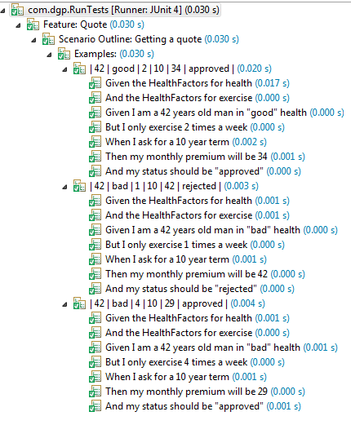
Scenario Outline cont.
Step Definitions
We now have data-driven testing, executing multiple independent instances of the same scenario
Feature: Quote
Scenario Outline: Getting a quote
Given the HealthFactors for health
| good | 0.9 |
| bad | 1.0 |
And the HealthFactors for exercise
| key | value |
| 1 | 1.0 |
| 2 | 0.9 |
| 3 | 0.8 |
| 4 | 0.7 |
Given I am a <age> years old man in "<health>" health
But I only exercise <exercise> times a week
When I ask for a <term> year term
Then my monthly premium will be <premium>
And my status should be "<status>"
Examples:
| age | health | exercise | term | premium | status |
| 42 | good | 2 | 10 | 34 | approved |
| 42 | bad | 1 | 10 | 42 | rejected |
| 42 | bad | 4 | 10 | 29 | approved |
20170313
Copyright © 2017 nTier Training, LLC. All rights reserved.
5-<number>
Notes:
20170313
Copyright © 2017 nTier Training, LLC. All rights reserved.
5-<number>
TDD and BDD

Slide 43
Lab 5.2
Cucumber – Scenario Outline
Notes:
20170313
Copyright © 2017 nTier Training, LLC. All rights reserved.
5-<number>
TDD and BDD

Slide 44
Lab 5.2 - Cucumber
Change your file src\main\resources\com\ntier\life\insurance\insure.feature to be a Scenario Outline
Remember to replace hard coded values with <> placeholders
You will need to create an Examples table
20170313
Copyright © 2017 nTier Training, LLC. All rights reserved.
5-<number>
Notes:
20170313
Copyright © 2017 nTier Training, LLC. All rights reserved.
5-<number>
TDD and BDD

Slide 45
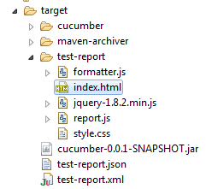
@CucumberOptions
You may want to have a little better reporting generated than the default, such as being able to see the details of the scenario that has executed. You can do this by changing your TestRunner.java and using Cucumber options
Above we have three formatters:
  The “pretty” refers to Cucumber’s formatter that provides nice looking output that shows scenario details in the console
  The HTML formatter generates a series of files in the test-report directory
  The JSON formatter outputs a report in JSON-compliant format
@RunWith(Cucumber.class)
@CucumberOptions(format={"pretty",
"html:target/test-report",
"json:target/test-report.json",
"junit:target/test-report.xml"})
public class RunTests {
}
20170313
Copyright © 2017 nTier Training, LLC. All rights reserved.
5-<number>
Notes:
Alternatively, with some newer versions of the Cucumber jars you will use the plugin attribute instead of pretty
@RunWith(Cucumber.class)
@CucumberOptions(plugin={"pretty","json:target/test-report.json"},
features="test/features",
monochrome=true, tags={"@Singular"})
public class RunTests {
}
20170313
Copyright © 2017 nTier Training, LLC. All rights reserved.
5-<number>
TDD and BDD

Slide 46
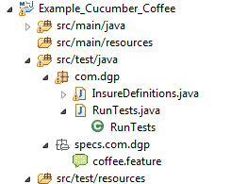
Where Are My Feature Files?
What if you want to store your feature files in something other than src/test/resources? For example: src/test/java/specs
The tags attribute can control what scenarios are executed in a Feature by listing the annotated scenarios to execute. Below, in the notes, only one of these scenarios will be run by this JUnit. The monochrome=true helps format the console output report
@RunWith(Cucumber.class)
@CucumberOptions(format={"pretty",
"html:target/test-report",
  "json:target/test-report.json",
  "junit:target/test-report.xml"
  }, features="src/test/java/specs"
  , tags={"@GetTwo"}
  , monochrome=true)
public class RunTests {
}
20170313
Copyright © 2017 nTier Training, LLC. All rights reserved.
5-<number>
Notes:
Feature: Coffee
Scenario: getting a cup of coffee
Given A store sells coffee at 3.99 a cup
When I ask for 1 cups
Then my bill will be "3.99"
@GetTwo
Scenario: getting two cups of coffee
Given A store sells coffee at 3.99 a cup
When I ask for 2 cups
Then my bill will be "7.98“
Feature: Coffee
@GetTwo
Scenario: getting two cups of coffee # com/dgp/coffee.feature:9
Given A store sells coffee at 3.99 a cup # InsureDefinitions.A_strore_sells_coffee_at_a_cup(double,double)
When I ask for 2 cups # InsureDefinitions.I_ask_for_a_cup(int)
Then my bill will be "7.98" # InsureDefinitions.my_bill_will_be(String)
1 Scenarios (1 passed)
3 Steps (3 passed)
0m0.087s
20170313
Copyright © 2017 nTier Training, LLC. All rights reserved.
5-<number>
TDD and BDD

Slide 47
Cucumber Reports
The Cucumber JVM contains some set of predefined reports
Cucumber reporting solution is provided as a Java library which can be included as any dependency via Jar, Maven, Gradle
Report generation can be triggered somewhere within Java code. It is assumed that base JSON reports have already been generated by Cucumber JVM, so we just have to point to existing JSON result files
<dependency>
<groupId>com.github.mkolisnyk</groupId>
<artifactId>cucumber-reports</artifactId>
<version>0.0.2</version>
</dependency>
20170313
Copyright © 2017 nTier Training, LLC. All rights reserved.
5-<number>
Notes:
20170313
Copyright © 2017 nTier Training, LLC. All rights reserved.
5-<number>
TDD and BDD

Slide 48
Generate HTML Report
Using our @CucumberOptions annotation, we generate a JSON report:
We then use it via the following code to create an HTML equivalent report:
@RunWith(Cucumber.class)
@CucumberOptions(format={"pretty","json:target/test-report.json"},
features="src/test/java/features",
monochrome=true)
public class RunTests {
}
CucumberResultsOverview results = new CucumberResultsOverview();
results.setOutputDirectory("target");
results.setOutputName("cucumber-results");
results.setSourceFile("./target/test-report.json");
results.executeFeaturesOverviewReport();
20170313
Copyright © 2017 nTier Training, LLC. All rights reserved.
5-<number>
Notes:
Alternatively, with some newer versions of Cucumber you will use the plugin attribute instead of pretty
@RunWith(Cucumber.class)
@CucumberOptions(plugin={"pretty","json:target/test-report.json"},
features="test/features",
monochrome=true, tags={"@Singular"})
public class RunTests {
}
@Test
public void test() throws Exception {
CucumberResultsOverview results = new CucumberResultsOverview();
results.setOutputDirectory("target");
results.setOutputName("cucumber-results");
results.setSourceFile("target/test-report.json");
results.executeFeaturesOverviewReport();
}
20170313
Copyright © 2017 nTier Training, LLC. All rights reserved.
5-<number>
TDD and BDD

Slide 49
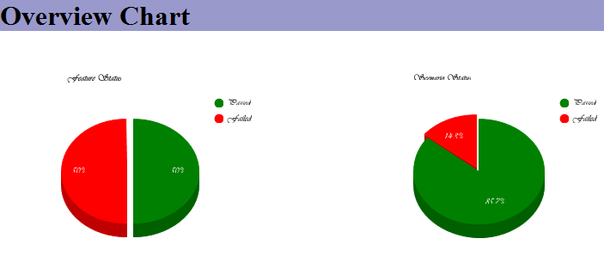
Cucumber Results
Overview Chart - Contains pie charts showing the ratio of passed/failed features and scenarios. A scenario is considered “failed” when it has failed steps. Otherwise, if the scenario has undefined steps (without any failed steps), the scenario status is undefined. In all other cases the scenario is treated as passed
20170313
Copyright © 2017 nTier Training, LLC. All rights reserved.
5-<number>
Notes:
20170313
Copyright © 2017 nTier Training, LLC. All rights reserved.
5-<number>
TDD and BDD

Slide 50
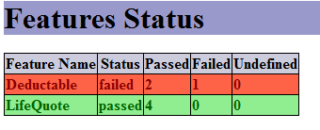
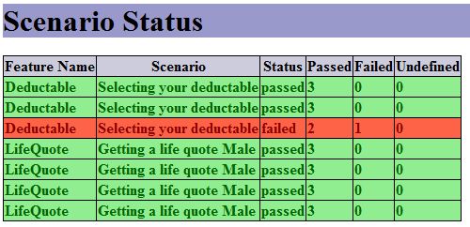
Cucumber Results cont.
Features Status - The table containing the list of features by their names and scenario run statistics. It shows the number of passed, failed and undefined scenarios for each specific features
Scenario Status - Is a more detailed breakdown where features are also split into scenarios. The table contains the number of passed, failed and undefined steps for each specific scenario
20170313
Copyright © 2017 nTier Training, LLC. All rights reserved.
5-<number>
Notes:
20170313
Copyright © 2017 nTier Training, LLC. All rights reserved.
5-<number>
TDD and BDD

Slide 51
Lab 5.3
Cucumber Options
Notes:
20170313
Copyright © 2017 nTier Training, LLC. All rights reserved.
5-<number>
TDD and BDD

Slide 52
Lab 5.3 – Reports!
Objective: Use Options on our JUnit runner to create some simple Cucumber reports
Make sure your pom.xml has the versions for the Cucumber and JUnit jars as in the notes
Move your feature file to a folder “src/test/java/features”
Amend your JUnit Runner to use @CucumberOptions with pretty formatting of the report and use the monochrome=true
Now you should get a nicely formatted report
20170313
Copyright © 2017 nTier Training, LLC. All rights reserved.
5-<number>
Notes:
20170313
Copyright © 2017 nTier Training, LLC. All rights reserved.
5-<number>
TDD and BDD

Slide 53
Lab 5.3 Get Selective
From the solution file in your last project, copy ONE Scenario from that feature file into the feature file of this new project (Lab05.3)
Run as before. Both the Scenario Outline and Scenario are executed as they both use the Same StepDefinition Class
In your lab setup for this lab you will find:
  The java class com.ntier.life.insurance.HealthPlan
  The java class com.ntier.life.insurance.DeductableStepDefinition
  The feature deductable.feature
Copy these items into your project at the appropriate place in your project’s structure
20170313
Copyright © 2017 nTier Training, LLC. All rights reserved.
5-<number>
Notes:
20170313
Copyright © 2017 nTier Training, LLC. All rights reserved.
5-<number>
TDD and BDD

Slide 54

Lab 5.3 – What’s Your Option?
Amend your @CucumberOptions to ONLY run one single Scenario from each feature. You will need to Annotate the Scenarios with an Annotation “@Singular” and reference it from @CucumberOption using the “tags” attributes. See the chapters slides for details
20170313
Copyright © 2017 nTier Training, LLC. All rights reserved.
5-<number>
Notes:
20170313
Copyright © 2017 nTier Training, LLC. All rights reserved.
5-<number>
TDD and BDD

Slide 55
Lab 5.3 [optional] Cucumber Reports
Objective: Generate an HTML Report of your Cucumber tests
In the lab startup file for Lab05.3 is a sub directory called “Cucumber-Reports”. You will find a new pom.xml containing the required dependency for Cucumber Reports
Replace your current project pom.xml with this pom.xml
There is also a file “GenerateReports.java”. Copy this into the package “com.ntier.life.insurance” in the src/test/java directory of your project
20170313
Copyright © 2017 nTier Training, LLC. All rights reserved.
5-<number>
Notes:
20170313
Copyright © 2017 nTier Training, LLC. All rights reserved.
5-<number>
TDD and BDD

Slide 56
Lab 5.3 [optional] Cucumber Reports
Change your existing Runtests JUnit class to include the generation of a JSON report of the test run (see slides)
Then run this new Runtests class
Then run the class GenerateReports
Refresh the project and see an HTML Report in the target directory of your project. That is where we told it to put it. The file is called “cucumber-results-feature-overview.html”
20170313
Copyright © 2017 nTier Training, LLC. All rights reserved.
5-<number>
Notes:
20170313
Copyright © 2017 nTier Training, LLC. All rights reserved.
5-<number>
TDD and BDD

Slide 57
Behavior-Driven Development
Selenium
User Stories
Behavior-Driven Development
Cucumber
Selenium
Notes:
20170313
Copyright © 2017 nTier Training, LLC. All rights reserved.
5-<number>
TDD and BDD

Slide 58
Selenium Testing
The testing of websites with respect to user stories and user interactions is well supported by Cucumber-JVM and Selenium
The browser can be programmatically tested (i.e., the DOM model created by web pages, the flow of a story through various pages)
Selenium has a rich API to interrogate web pages, courtesy of the org.openqa.selenium package
  http://selenium.googlecode.coSelenium automates browsers.m/svn/trunk/docs/api/java/org/openqa/selenium/package-summary.html
20170313
Copyright © 2017 nTier Training, LLC. All rights reserved.
5-<number>
Notes:
20170313
Copyright © 2017 nTier Training, LLC. All rights reserved.
5-<number>
TDD and BDD

Slide 59
WebDriver
The Interface org.openqa.selenium.WebDriver provides a number of implementation classes for different browsers in order to test web pages in the browser
It aims to provide a friendly API that's easy to explore and understand, which will help make your tests easier to read and maintain
WebDriver driver = new FirefoxDriver();
driver.get("http://www.google.com");
WebElement element = driver.findElement(By.name("q"));
element.sendKeys("Cats");
element.submit();
System.out.println("Page title is: " + driver.getTitle());
20170313
Copyright © 2017 nTier Training, LLC. All rights reserved.
5-<number>
Notes:
20170313
Copyright © 2017 nTier Training, LLC. All rights reserved.
5-<number>
TDD and BDD

Slide 60
Simulation via a Story – Do You Yahoo?
We can use this approach to testing in our Cucumber story files
Feature: Yahoo
Scenario: Yahoo Search
Given WebDriver is initialized "https://www.yahoo.com/"
When a user enters "Cats" in the searchbox "p"
Then the page title is "Cats - Yahoo Search Results"
When a user clicks the link "Cat - Wikipedia, the free encyclopedia"
Then the page text contains "the free encyclopedia"
20170313
Copyright © 2017 nTier Training, LLC. All rights reserved.
5-<number>
Notes:
20170313
Copyright © 2017 nTier Training, LLC. All rights reserved.
5-<number>
TDD and BDD

Slide 61
Simulation of a Website via a Story
The first part of the story is to get to the Yahoo home page (https://www.yahoo.com/), so we need a WebDriver. We selected Firefox
Then we simulate key entry and form submission
private WebDriver driver;
@Given("^WebDriver is initialized \"([^\"]*)\"$“
public void WebDriver_is_initialized(String arg1) {
  System.setProperty
  ("webdriver.chrome.driver", "c://chromedriver.exe");
  driver = new ChromeDriver();driver.get(arg1);
}
@When("^a user enters \"([^\"]*)\" in the searchbox \"([^\"]*)\"$")
public void a_user_enters_in_the_searchbox(String arg1, String arg2) {
  WebElement element = driver.findElement(By.name(arg2));
  element.sendKeys(arg1);
  element.submit();
}
20170313
Copyright © 2017 nTier Training, LLC. All rights reserved.
5-<number>
Notes:
We locate the search text box, simulate key entry and submit the form that it is encapsulated in
20170313
Copyright © 2017 nTier Training, LLC. All rights reserved.
5-<number>
TDD and BDD

Slide 62
Simulation of a Link
A new request has been made and with it comes a new response, so we verify it is the page we expected using title
Now simulate a click of a hyperlink
And verify we have the correct page, perhaps via contained chars
@Then("^the page title is \"([^\"]*)\"$")
public void the_page_title_is(String arg1) {
  Assert.assertEquals(arg1, driver.getTitle());
}
@When("^a user clicks the link \"([^\"]*)\"$")
public void a_user_clicks_the_link(String arg1) {
  driver.findElement(By.linkText(arg1)).click();
}
@Then("^the page text contains \"([^\"]*)\"$")
public void the_page_text_contains(String arg1) {
  Assert.assertTrue(arg1, driver.getPageSource().contains(arg1));
}
20170313
Copyright © 2017 nTier Training, LLC. All rights reserved.
5-<number>
Notes:
We may want to close the browser at the end of our final step
driver.quit();
20170313
Copyright © 2017 nTier Training, LLC. All rights reserved.
5-<number>
TDD and BDD

Slide 63
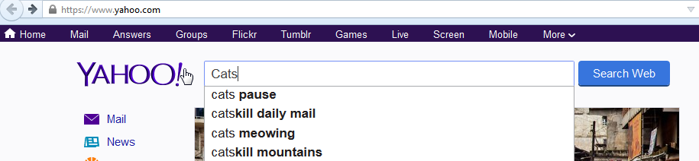
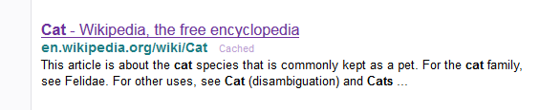
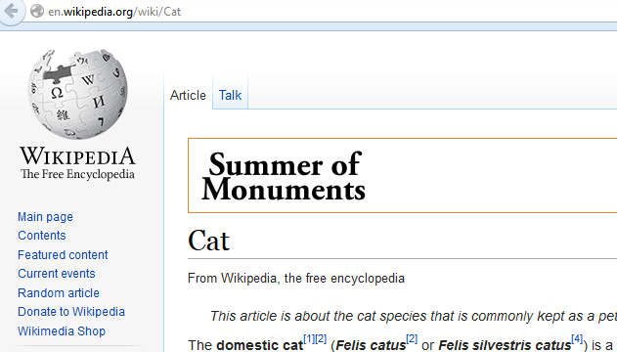
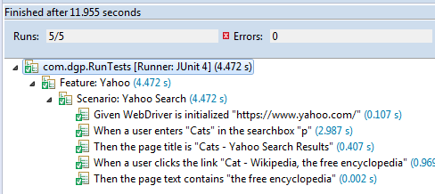
Our Simulated Page flow
20170313
Copyright © 2017 nTier Training, LLC. All rights reserved.
5-<number>
Notes:
20170313
Copyright © 2017 nTier Training, LLC. All rights reserved.
5-<number>
TDD and BDD

Slide 64
Lab 5.5
Cucumber – Selenium
Notes:
20170313
Copyright © 2017 nTier Training, LLC. All rights reserved.
5-<number>
TDD and BDD

Slide 65
Lab 5.5 - Cucumber
Lab 5.4 - Walk
Objective: Test a website using Cucumber over Selenium
Import the existing project Lab05.4 from the lab setup directory.
You will need a Chrome Web Driver. This is in your lab setup. Execute the exe you will find there.
20170313
Copyright © 2017 nTier Training, LLC. All rights reserved.
5-<number>
Notes:
20170313
Copyright © 2017 nTier Training, LLC. All rights reserved.
5-<number>
TDD and BDD

Slide 66
Lab 5.5 - Cucumber
Lab 5.4 - Walk
In the file com.translate.translate.feature, complete the Scenario “Translate Cat”
  We will use the URL "http://www.spanishdict.com/translation"
  The user will input "cat" in the searchbox "text"
  The next page should have a url of “translate/cat”
  You must set the location of your chromeDriver.exe via a system property
    System.setProperty("webdriver.chrome.driver", "c://chromedriver.exe");
20170313
Copyright © 2017 nTier Training, LLC. All rights reserved.
5-<number>
Notes:
You ill need a Chrome Web Driver
20170313
Copyright © 2017 nTier Training, LLC. All rights reserved.
5-<number>
TDD and BDD

Slide 67
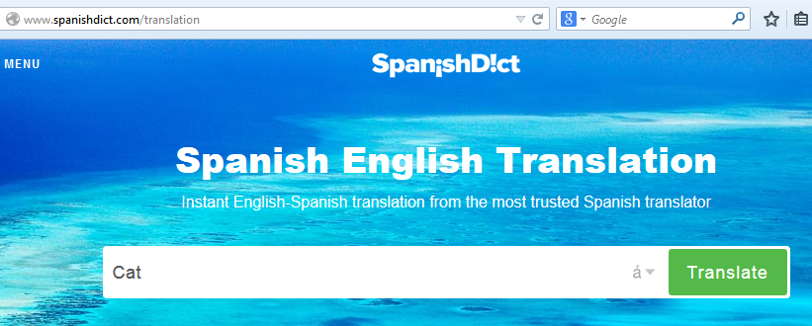
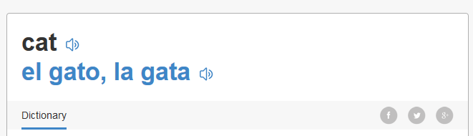
Lab 5.5 - Translate
Use the existing Junit “RunTests” to generate the Cucumber expressions. Paste the console output into the class TranslateStepDefinitions
Complete the class TranslateStepDefinitions using examples from the slides and test!
20170313
Copyright © 2017 nTier Training, LLC. All rights reserved.
5-<number>
Notes:
20170313
Copyright © 2017 nTier Training, LLC. All rights reserved.
5-<number>
TDD and BDD

